Slide 1



LinkMingle(Blogging Application) PROJECT BY: 1.Ajay Valapkar
valapkarajay2002@gmail.com
2.Singh Ambuj
ambujsingh1015@gmail.com
3.Shubhanakar Mane
shubhankarmane99@gmail.com

Slide 2

INTRODUCTION
In the dynamic realm of the digital era, blogging stands as a powerful medium for self-expression, knowledge sharing, and community engagement. As the popularity of blogging continues to soar, the need for an innovative, user-centric platform has never been more apparent. Our project, the "Innovative Blogging Application for Engaging Content Creation and Community Interaction," strives to fulfill this need by reimagining the blogging experience for both creators and readers.
In this age of information overload, where attention spans are fleeting, our application is designed to captivate and empower users in the world of blogging. We have embarked on a journey to create a platform that seamlessly blends intuitive design with cutting-edge features, ensuring a vibrant and enriching environment for content creators and consumers alike.
Our blogging application aims to provide an unparalleled user experience by focusing on several key aspects
Simplified Content Creation: We understand the importance of an intuitive and user-friendly interface for content creation. Our application offers diverse creation tools, allowing users to express themselves through text, images, videos, and interactive media effortlessly.
Community Engagement: We believe that blogging should be a collaborative and interactive experience. Our platform encourages meaningful discussions, facilitates collaboration, and fosters a sense of community among bloggers, amplifying the impact of their ideas and stories.

Slide 3

Features & functionality of the Link Mingle
User Registration and Profiles:
Feature: Users can create accounts to access the application, customize profiles, and manage their personal information.
ContentFunctionality: Allows users to personalize their profiles, display expertise, interests, and past blog posts, fostering a sense of identity within the community.
Feature: Users can create, edit, and publish various types of content, including text, images, videos, and interactive media.
Functionality: Provides an intuitive editor with formatting tools, media embedding, and real-time previews, making content creation a seamless and enjoyable process
Content Discovery and Recommendations:
Feature: Users receive personalized content recommendations based on their preferences, reading history, and interactions.
Functionality: Utilizes algorithms to analyze user behavior and suggest related content, enhancing the user's browsing experience and exposure to new blogs.
Used Tools and Technologies
Technology/Domain: Java
Front-End: Html, CSS, Database SQl,Angular
Back-end: Java,SpringBoot

Slide 4
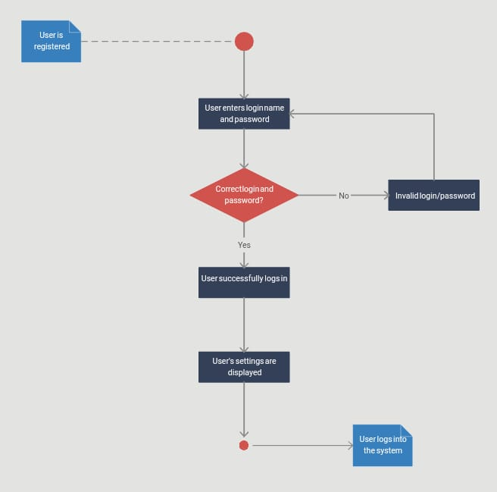
DIAGRAMS FOR Link Mingle PROJECT LOGIN
ACTIVITY DIAGRAM:

Slide 5
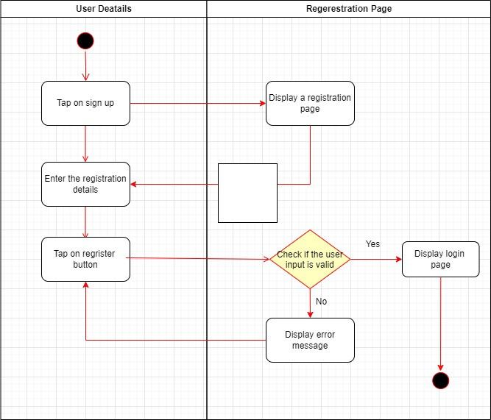
REGISTRATION ACTIVITY DIAGRAM:

Slide 6
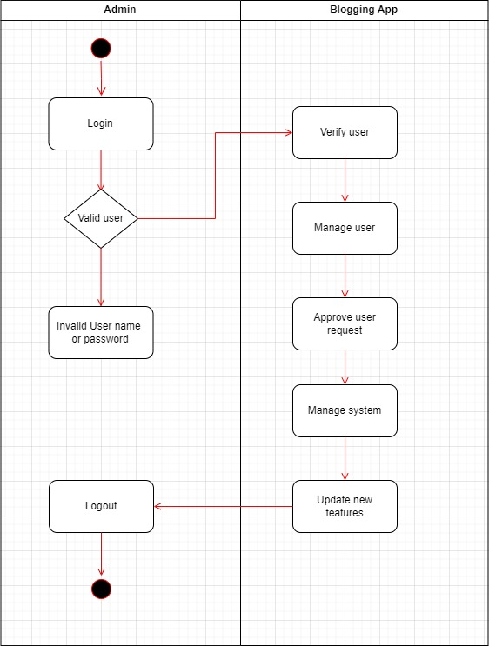
ADMIN ACTIVITY DIAGRAM:

Slide 7

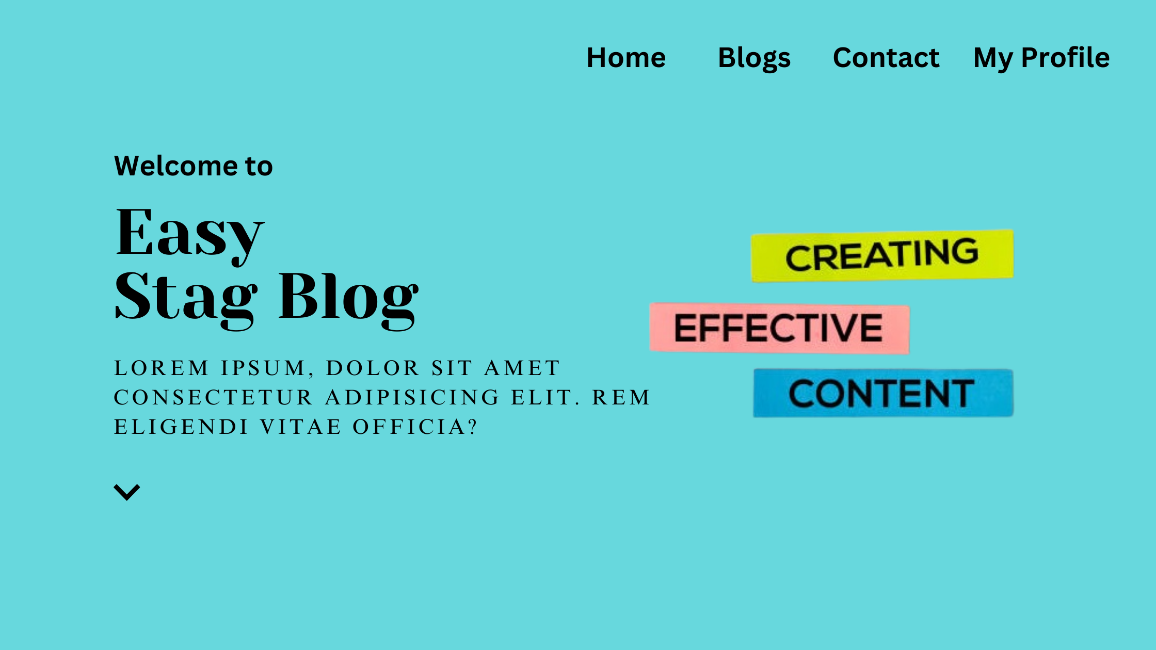
DESIGN AND IMPLEMENTATION OF Link Mingle Application:

Slide 8
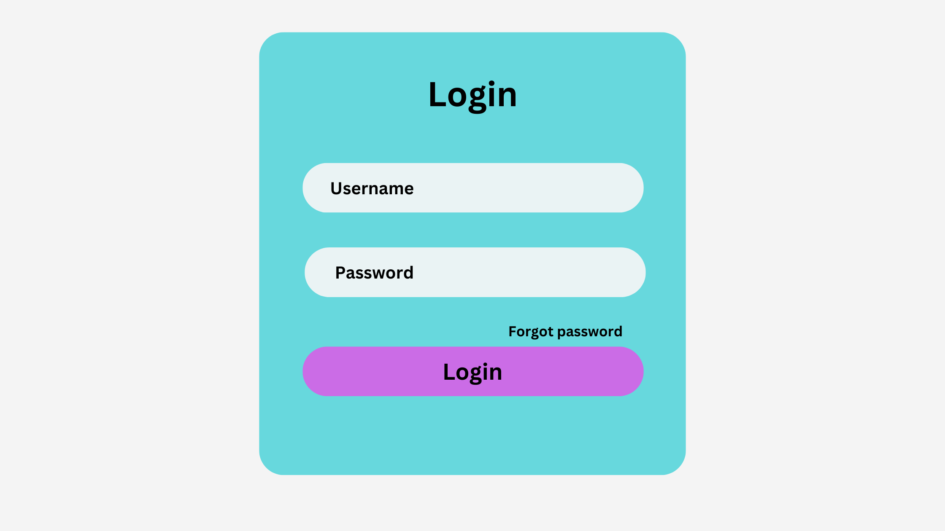

Slide 9
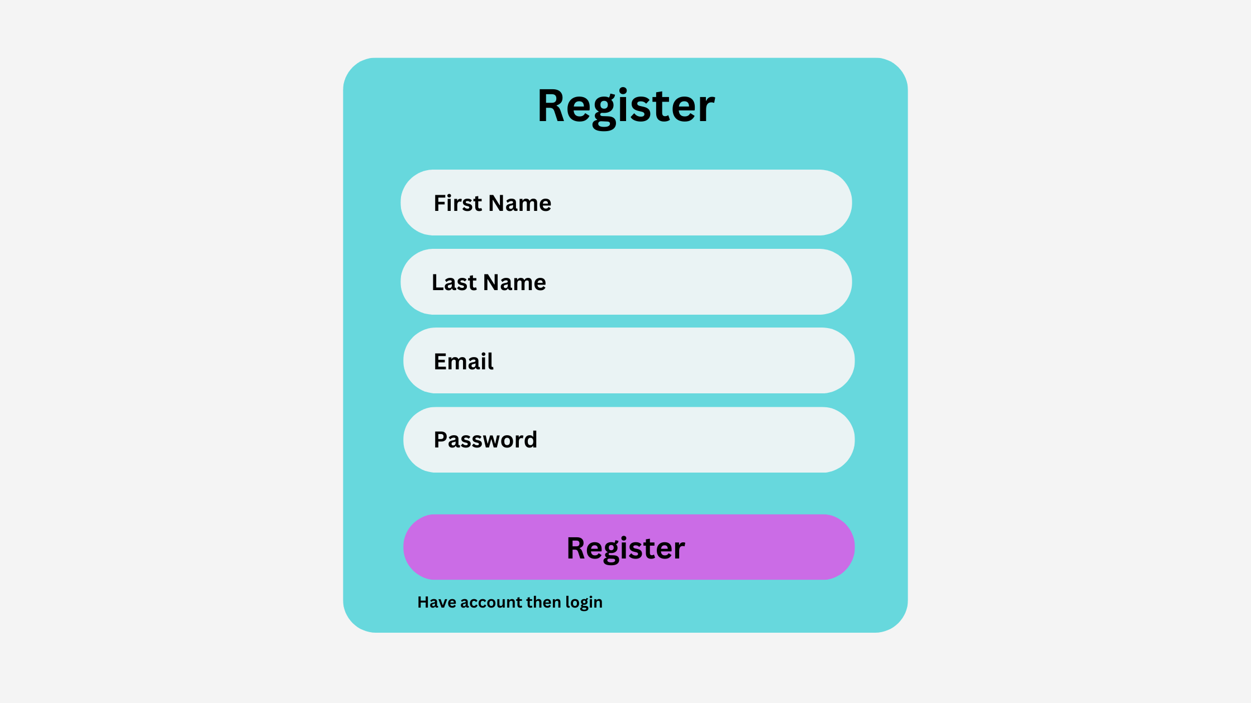

Slide 10
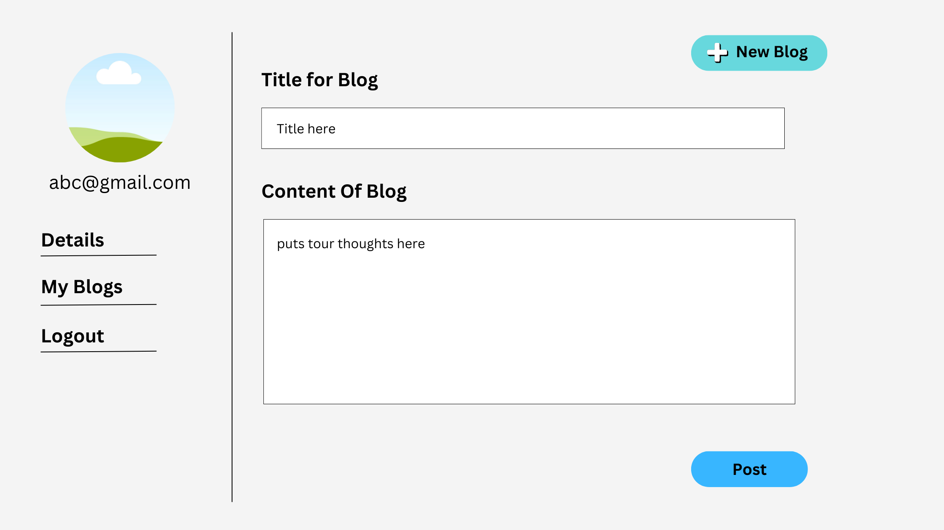

Slide 11
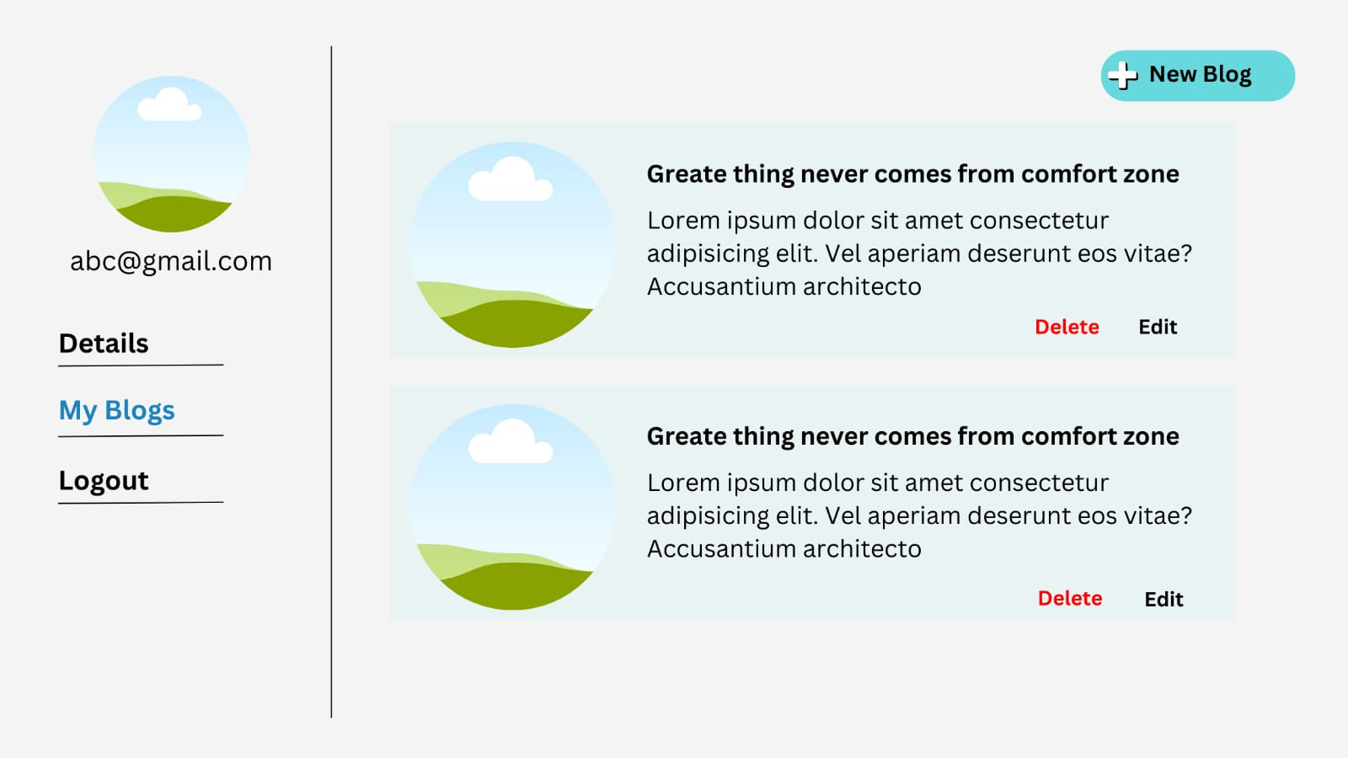

Slide 12
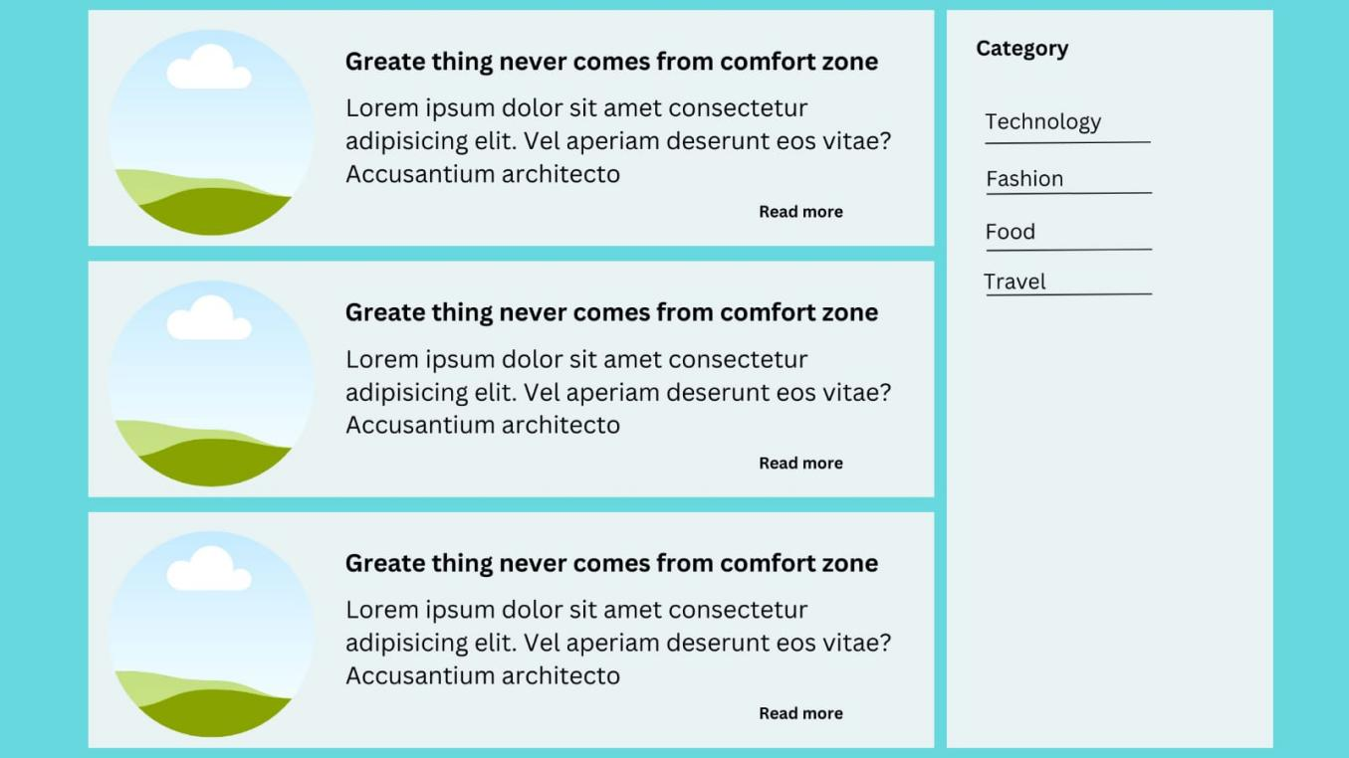

Slide 13

CONCLUSION
. In conclusion, the development of our Innovative Link Mingle marks a significant leap forward in the world of digital content creation and engagement. Through this project, we have strived to create a platform that not only simplifies the process of sharing thoughts and ideas but also fosters a vibrant and interactive community of bloggers and readers.
Our application's key features, such as effortless content creation, interactive comments, personalized user profiles, and collaborative blogging, have been meticulously designed to provide an enriching experience for both content creators and consumers. The inclusion of features like content recommendations, social media integration, and real-time notifications further enhances user engagement and extends the reach

